Slide 1
Digitization of large-format documents from the conservator's point of view
What can We do for each other?

Slide 2
Conservation process
Survey
Photography
Quality of paper and recording media
Mechanical cleaning
Sponges, rubbers, spatulas, scalpels, vacuum cleaners
Water based cleaning
Pure (warm) water with optional addition of surfactants
In bath or poured through on vacuum table
Typology (book, flat piece…)
Dust, molds, soot, etc.
Stains, old sizing agents, etc
Other cleaning
Cleaning with organic solvents
Paper bleaching
Notes:
Here You can see simplified scheme of conservation treatment with paper as most common archival material in mind. Every step can be usually done in few diffferent ways. Sometimes alternatively, sometimes We have to choose specific treatment right for the material in question.

Slide 3
Conservation process
Deacidification
Aqueous and non aqueous
Repairs
Documentation
Reconsolidation
Photography
Storage
Suitable materials and conditions
Often „tailored“
Individiual and mass processess
Mends and fill-ins
Rebinding in case of books, etc
Conservation report
Notes:
Do not be afraid, We will get back to them during next few minutes. What is important to mention is that complications with conservation treatment of large format archivals is usually due to their size, not that we use different methods.

Slide 4
Conservation process
Survey
Photography
Quality of paper and recording media
Mechanical cleaning
Sponges, rubbers, spatulas, scalpels, vacuum cleaners
Water based cleaning
Pure (warm) water with optional addition of surfactants
In bath or poured through on vacuum table
Typology (book, flat piece…)
Dust, molds, soot, etc.
Stains, old sizing agents, etc
Other cleaning
Cleaning with organic solvents
Paper bleaching
Notes:
First step, which is carried out always, is survey. We always take pictures at least before and after conservation treatment, but usually inbetween steps too. Sometimes these pictures are not used in the end, but can serve as landmark during work. We also make some schemes for example when book is sewn, because it is better, than photography. Also, it is not only photographs, but also analyses of state of matter, like pH measurement, paper composition, solubility of writing material and colors used, etc.
Sometimes we need assistance with unusual imaging techniques, such as photography in UV or IR spectrum.

Slide 5
Conservation process
Survey
Photography
Quality of paper and recording media
Mechanical cleaning
Sponges, rubbers, spatulas, scalpels, vacuum cleaners
Water based cleaning
Pure (warm) water with optional addition of surfactants
In bath or poured through on vacuum table
Typology (book, flat piece…)
Dust, molds, soot, etc.
Stains, old sizing agents, etc
Other cleaning
Cleaning with organic solvents
Paper bleaching
Notes:
First step, which is done almost always, even as the only one, is mechanical cleaning.

Slide 6
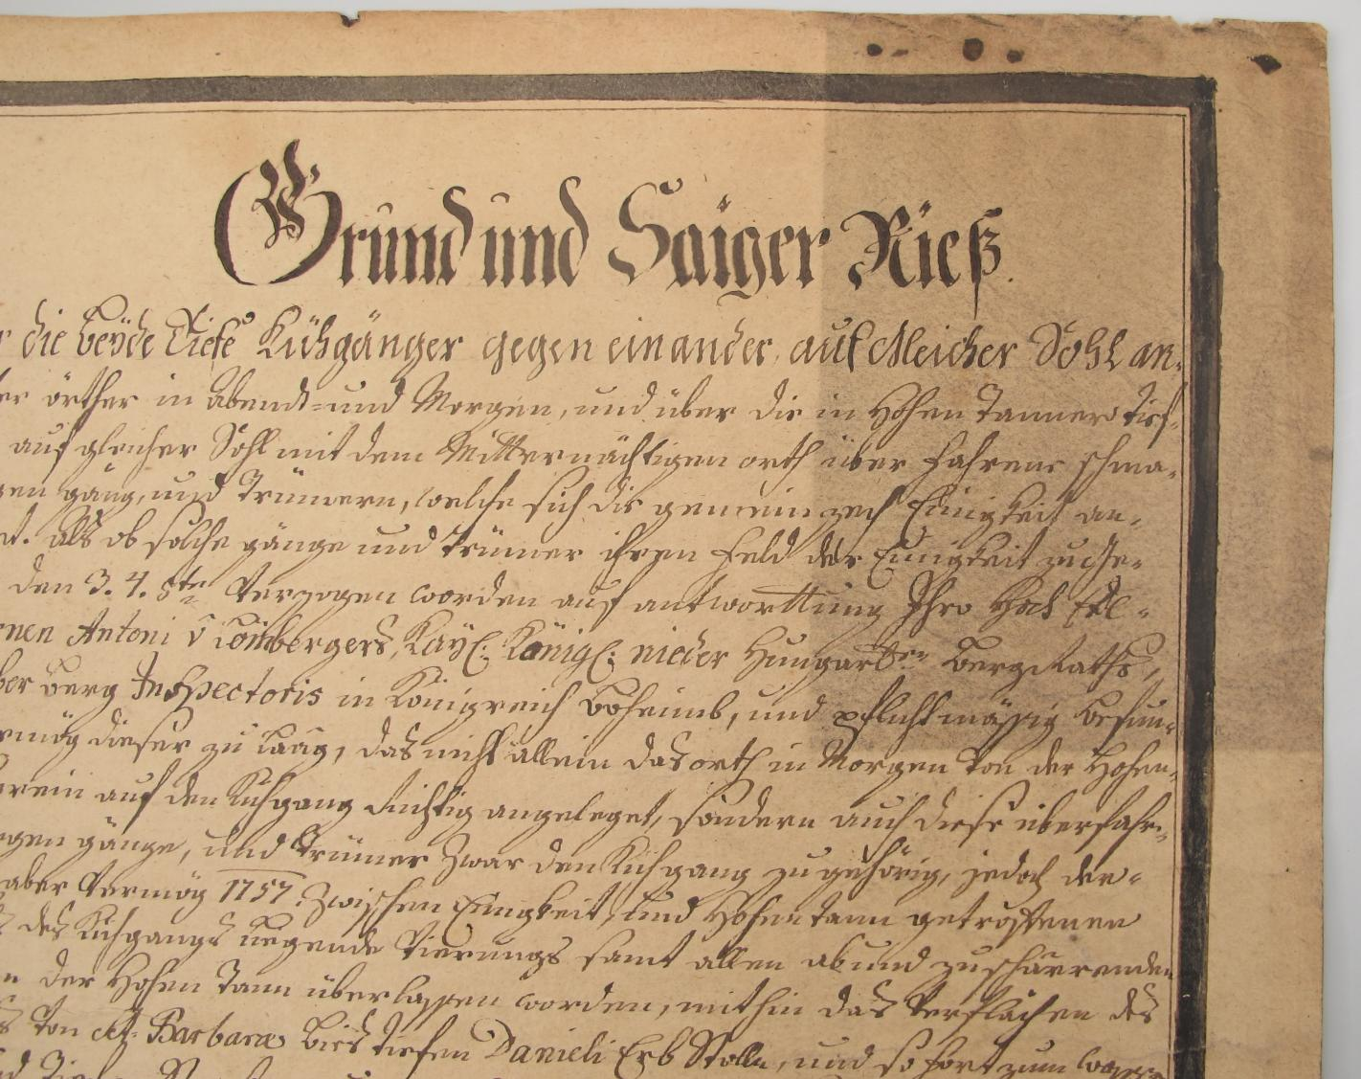
Notes:
Even just cleaning with erasers of some sort can enhance visibility of text or picture.

Slide 7
Conservation process
Survey
Photography
Quality of paper and recording media
Mechanical cleaning
Sponges, rubbers, spatulas, scalpels, vacuum cleaners
Water based cleaning
Pure (warm) water with optional addition of surfactants
In bath or poured through on vacuum table
Typology (book, flat piece…)
Dust, molds, soot, etc.
Stains, old sizing agents, etc
Other cleaning
Cleaning with organic solvents
Paper bleaching
Notes:
After that, we can use different methods, such as cleaning with water, surfactants and/or organic solvents.
Water based treatment can pose some risk due to potential change of dimensions. As paper is not homogenous material, the change also differs. This applies especially for machine made paper, which usually changes more in one direction.
Let me just briefly tell You about another water related problem, and that is floods. Because if repository is flooded, everything hit by water is affected. It means, that every paper can potentially change its dimensions. If there are dimensions written, for example on blueprints, it is fine, but with maps situation is bit different…

Slide 8
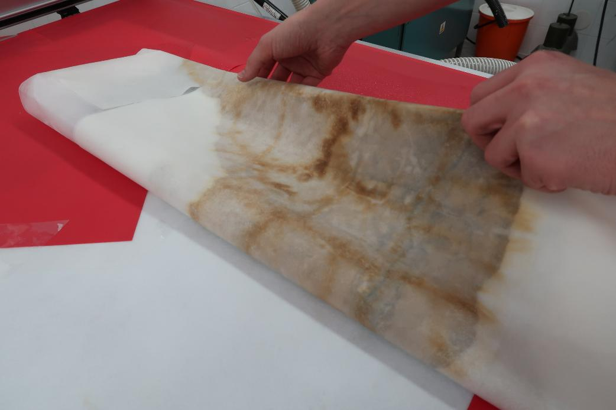
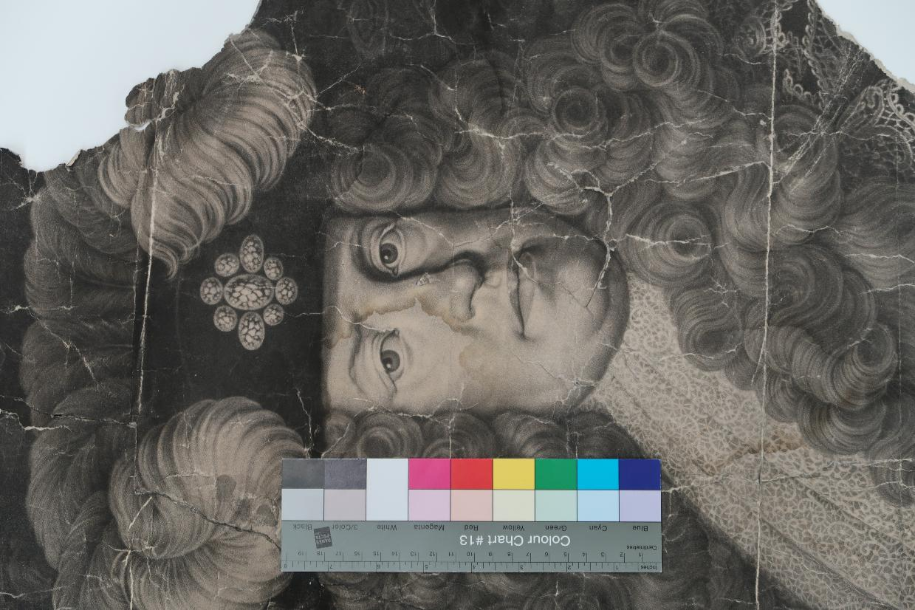
Notes:
We can wash out undesirable compounds, or soften old glues used on udesirable repairs

Slide 9
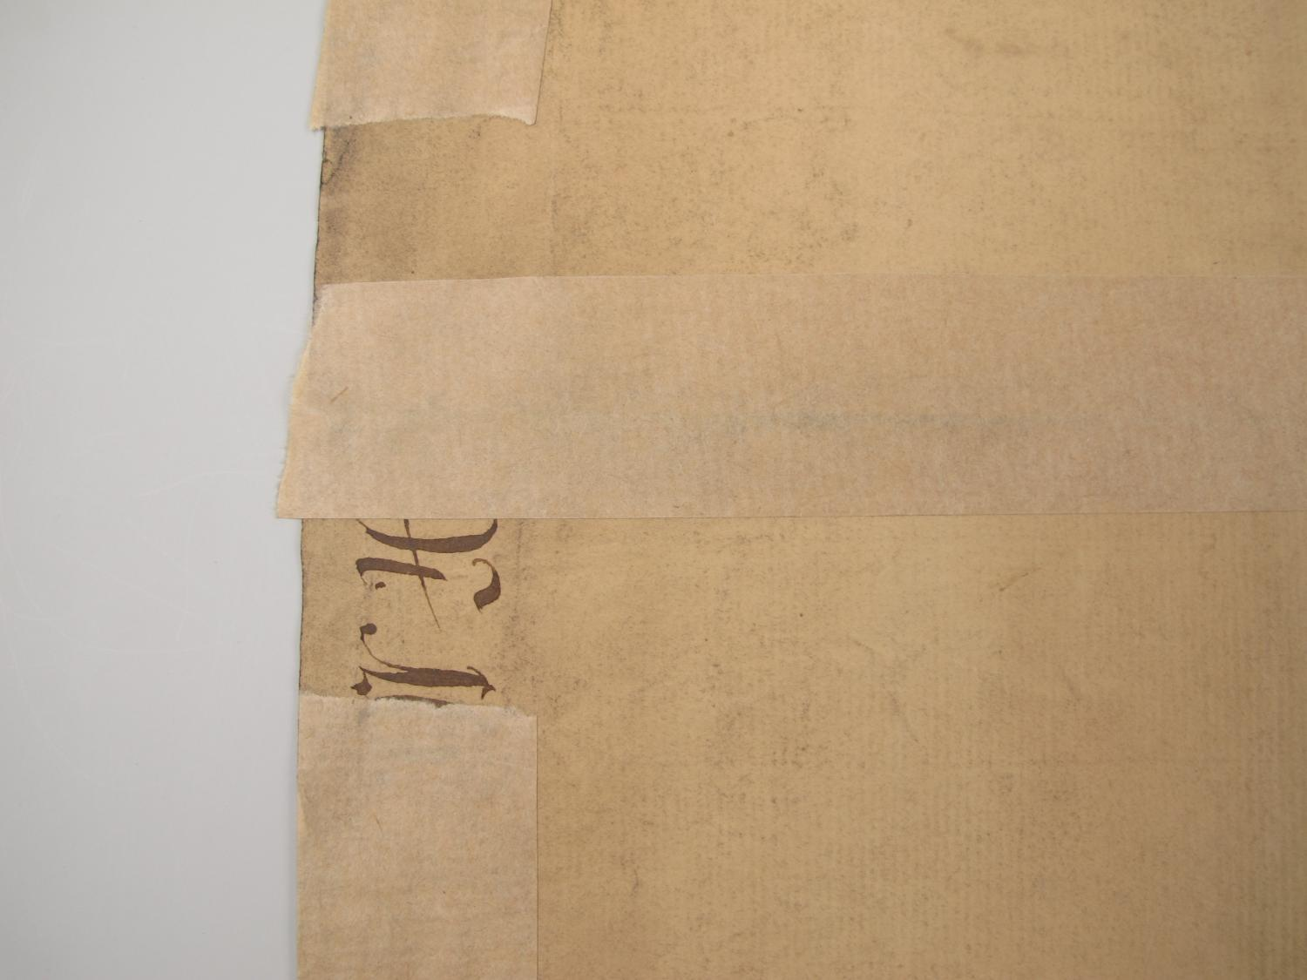
Notes:
We can wash out undesirable compounds, or soften old glues used on udesirable repairs

Slide 10
Conservation process
Deacidification
Aqueous and non aqueous
Repairs
Documentation
Reconsolidation
Photography
Storage
Suitable materials and conditions
Often „tailored“
Individiual and mass processess
Mends and fill-ins
Rebinding in case of books, etc
Conservation report

Slide 11
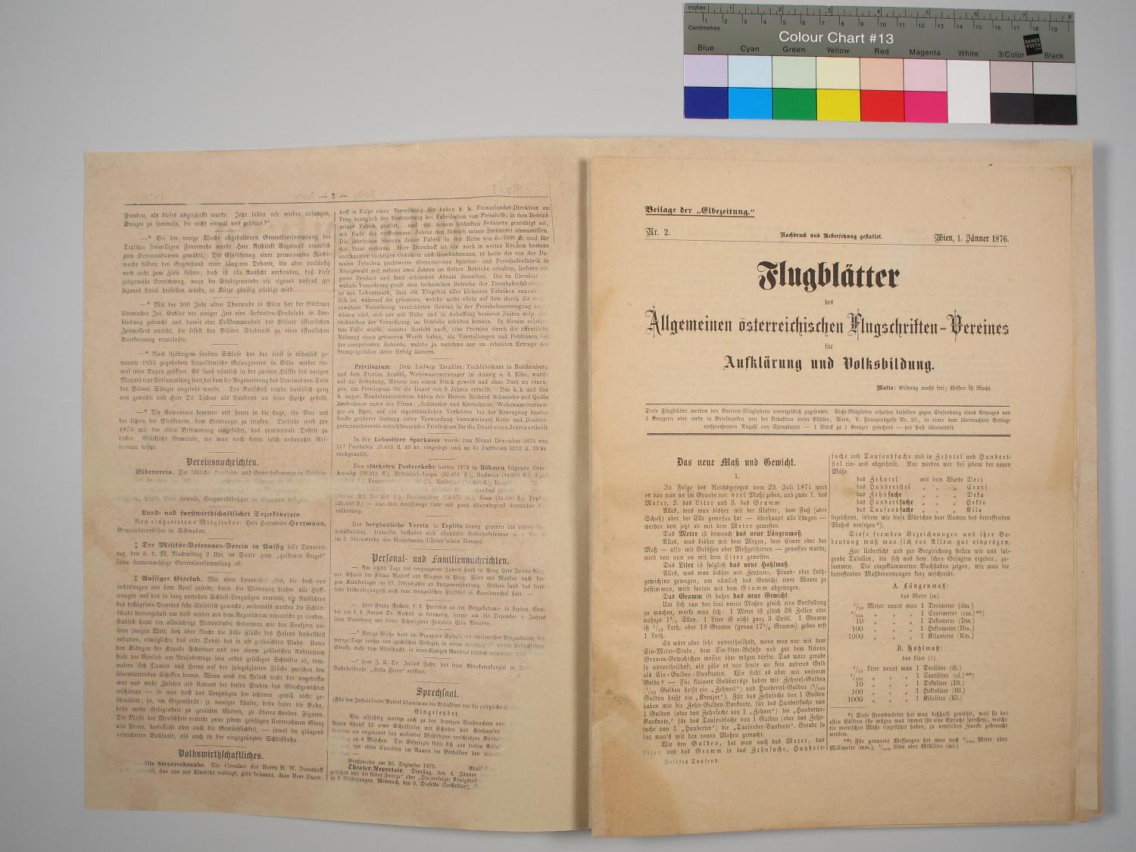
Notes:
From conservators point of view, repairs, does not need to be invisible, but should be done in a way, which is esthetically pleasing (so to speak „they do not disturb“) and does not obscure any information, as we saw before. Also this is usually the moment, which conservators consider as best for digitization of books, as materials are in sheets, but in good condition, repaired and usually readability is also improved.

Slide 12
Conservation process
Deacidification
Aqueous and non aqueous
Repairs
Documentation
Reconsolidation
Photography
Storage
Suitable materials and conditions
Often „tailored“
Individiual and mass processess
Mends and fill-ins
Rebinding in case of books, etc
Conservation report

Slide 13
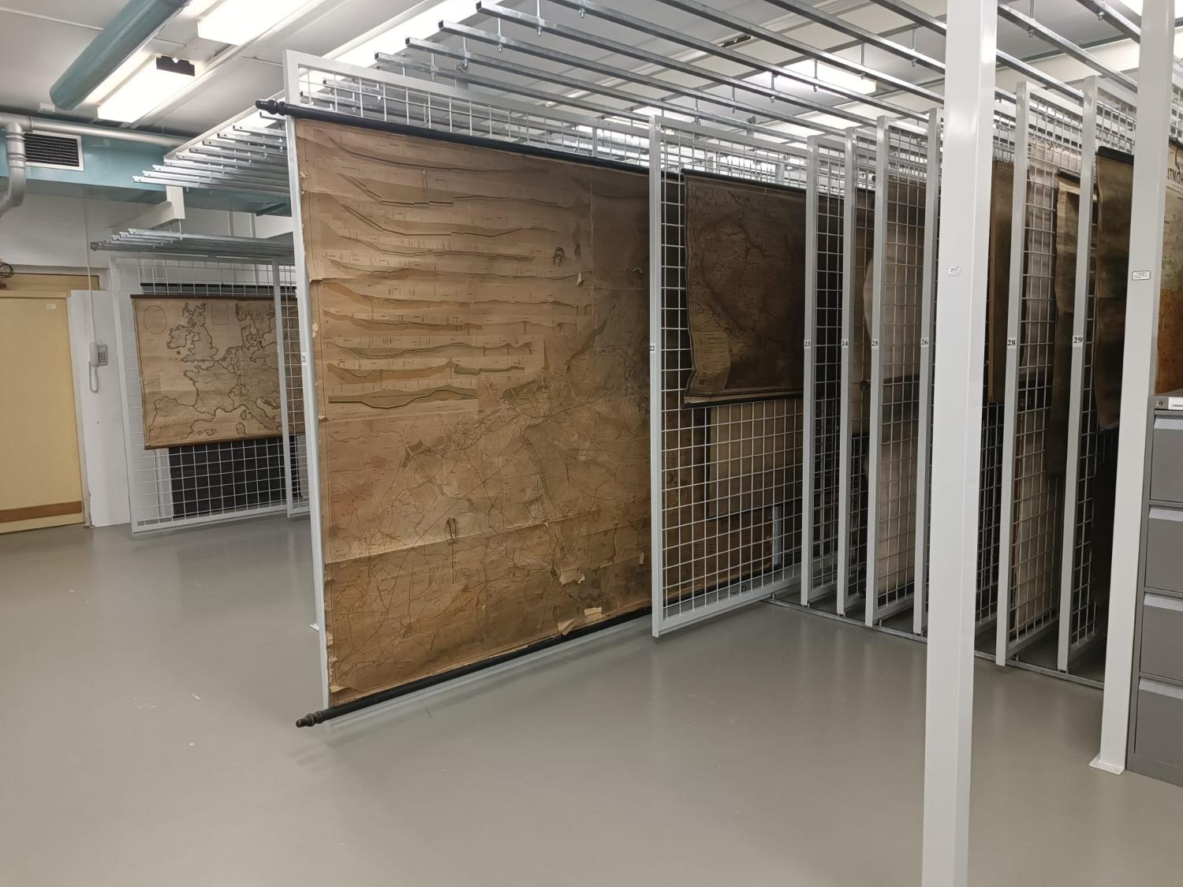
Notes:
I will not bother You with boring information about storage conditions, as they may vary between institutions and countries. But what is important about storage from conservators point of view, are posibilities of digital access. Somew Archivals are quite large and moving htem around can be problematic.

Slide 14
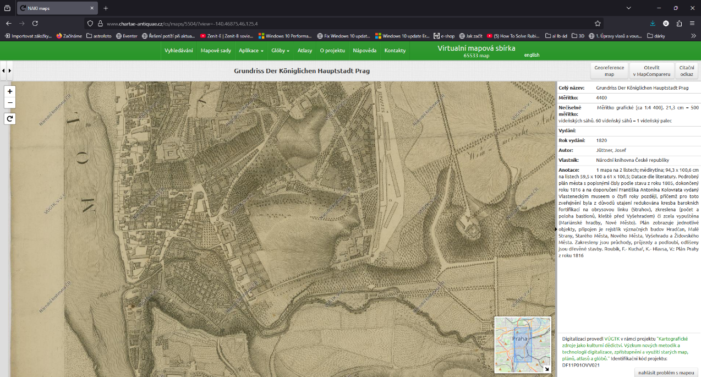
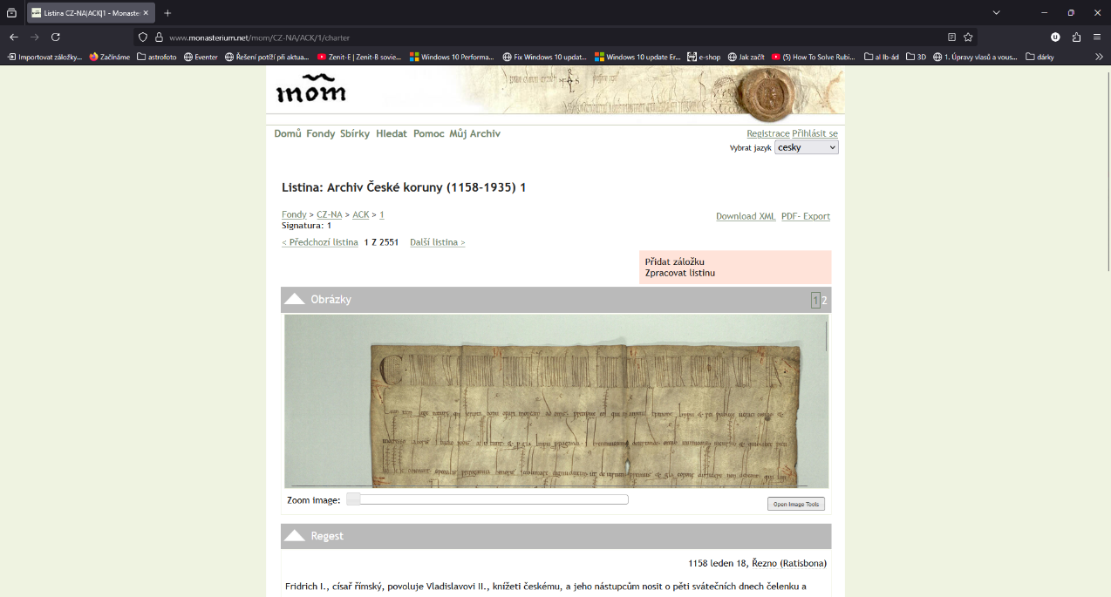
Notes:
For example in Czech archives, when there is digital copy, it should be provided to You as a researcher as first option. Only if You prove, that for your interest, physical study is necessary, You can see it. It may sound harsh, but it helps us protect originals for the future. On the other hand, collections can be in some cases accesed remotely, from home, for example. Especially with large format documents, this is especially covenient. For such application, online solution is great, as researcher can see whole document for context, but also smaller portions for study.
What is different is our effort to show the original to the public. Nevertheless digitized documents can be used as addendum to physical exhibits.

Slide 15
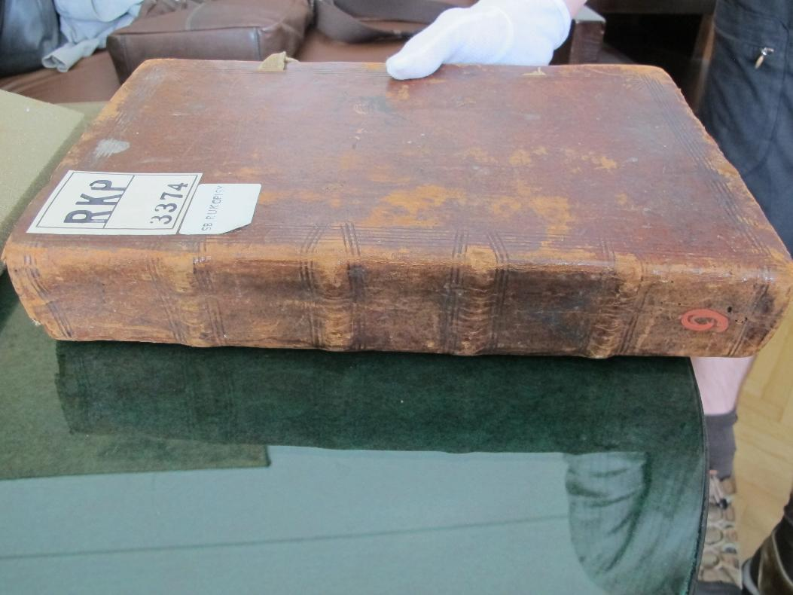
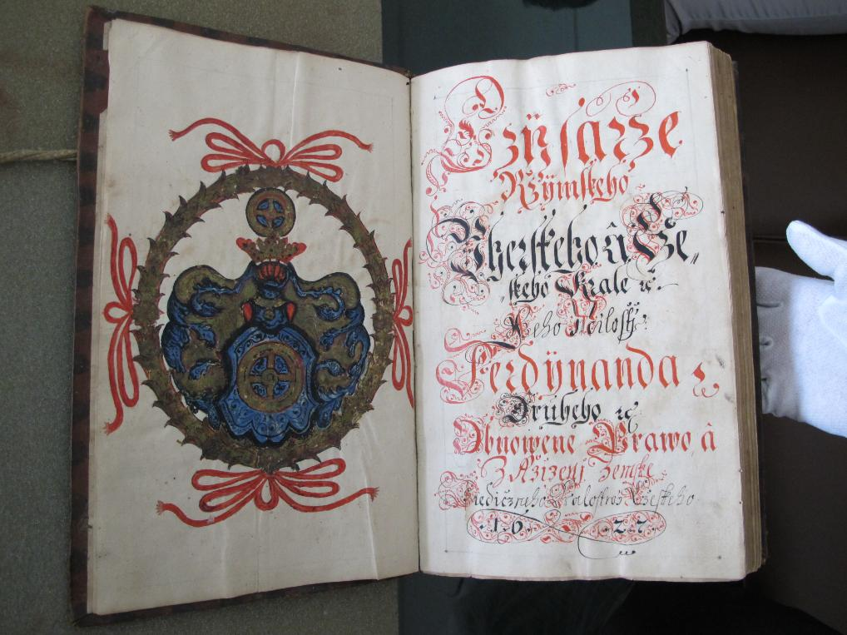
Notes:
And digitization also helps us to make copies and facsimiles. They can be in exhibitions for extended periods of time.

Slide 16
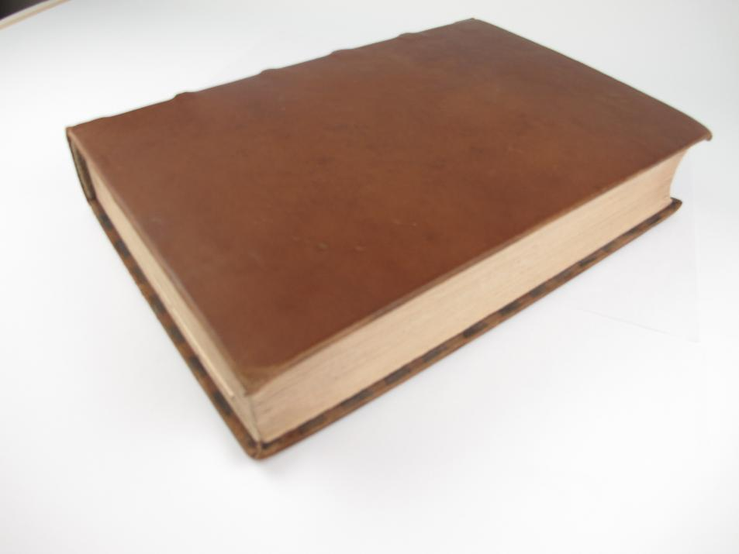
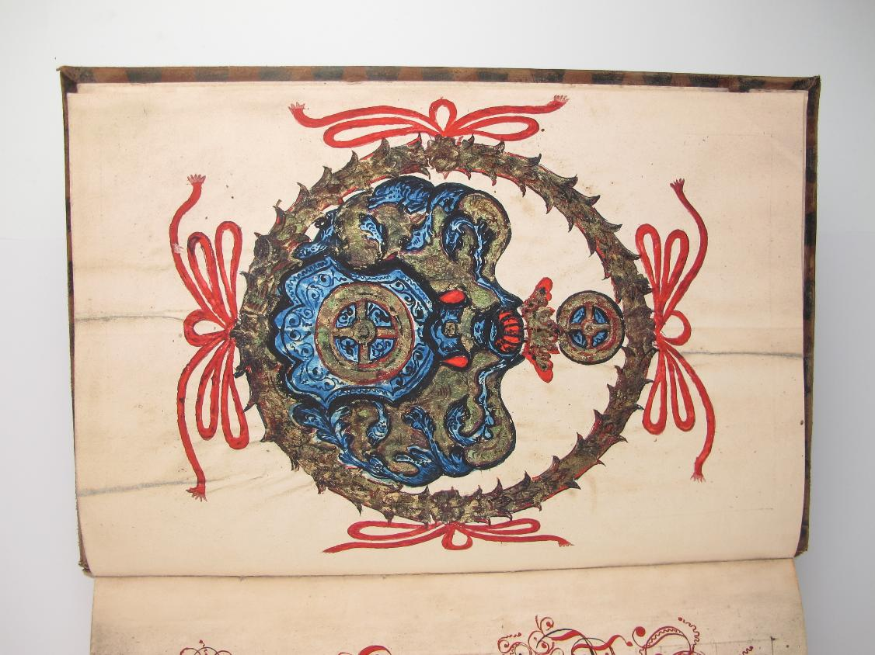
Notes:
As in this case.

Slide 17
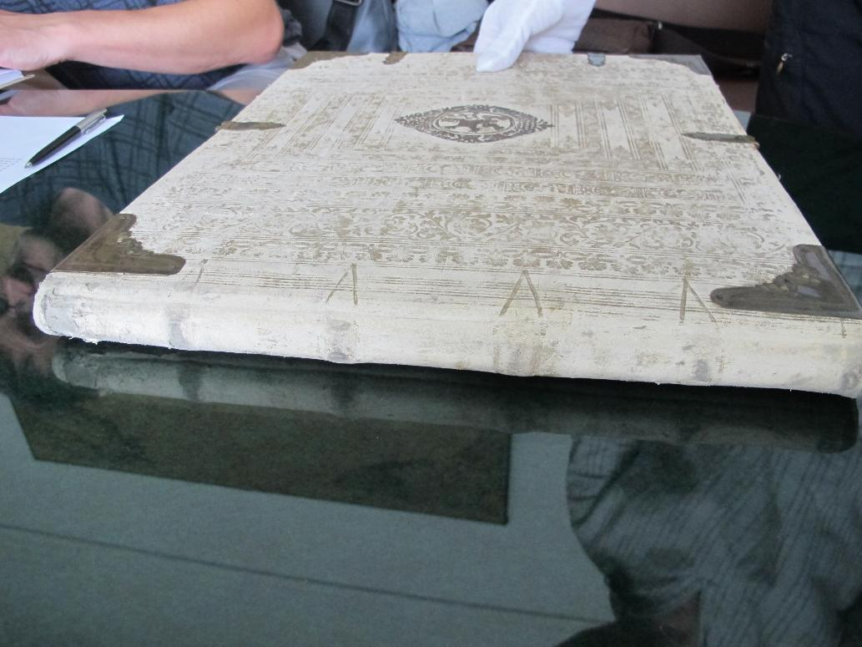
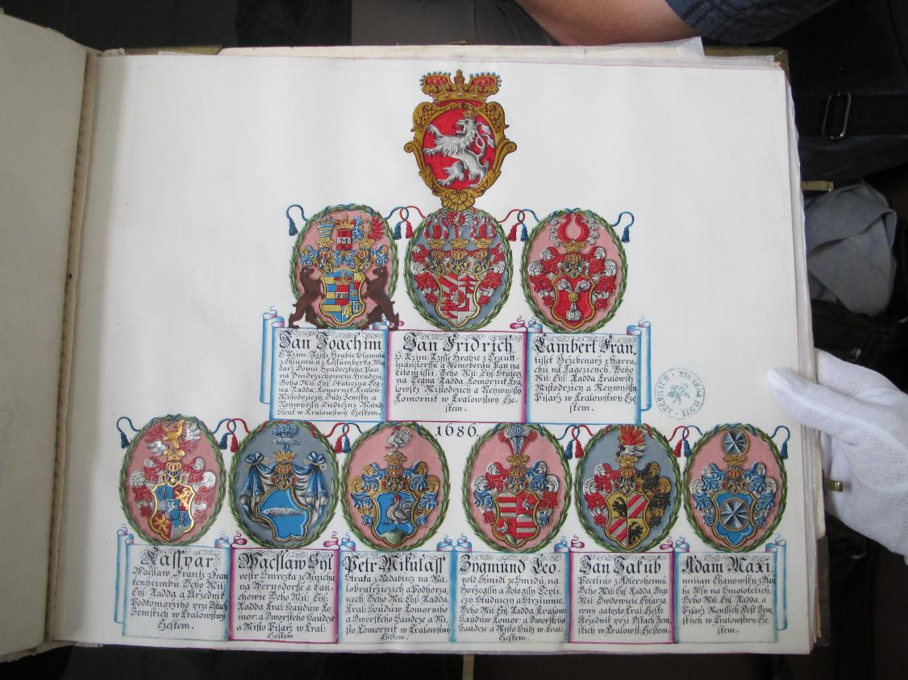
Notes:
Or this one.

Slide 18
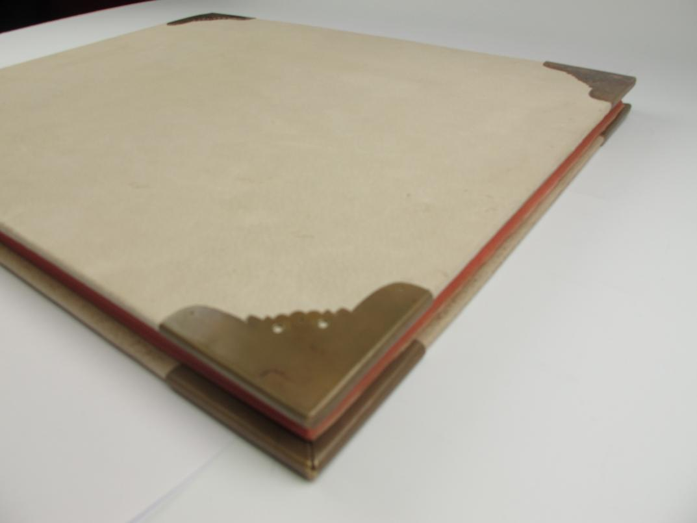
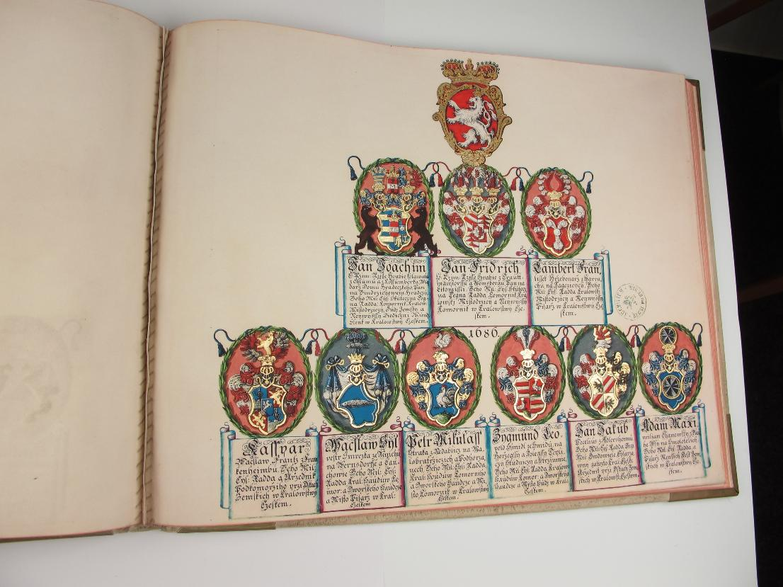
Notes:
As this one is printed and finalized with gulding and bound into book to look alike the original.

Slide 19
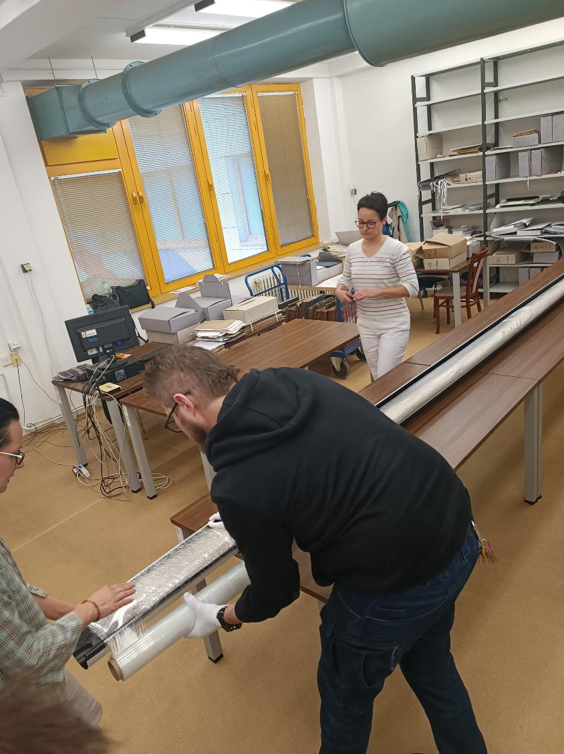
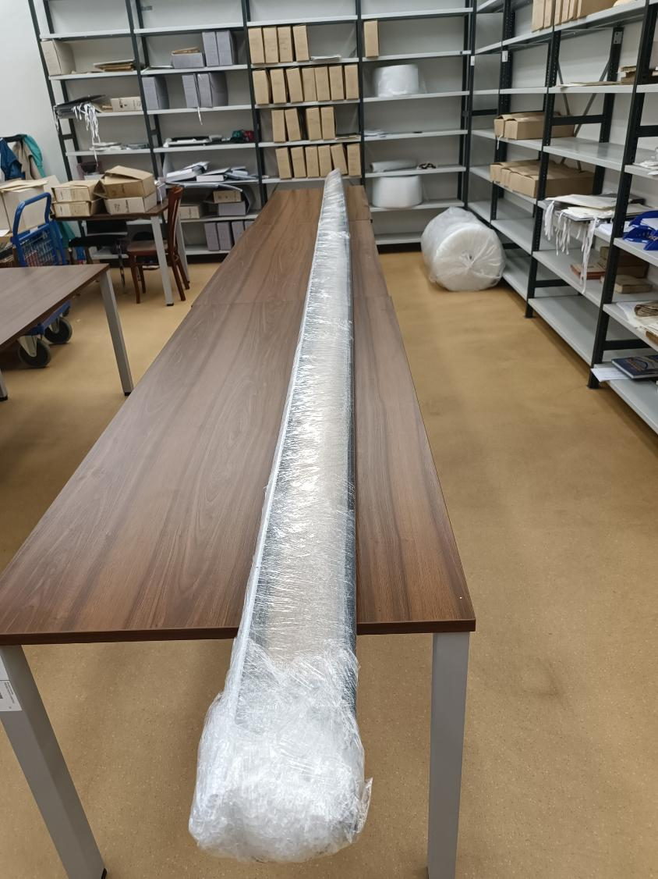
Notes:
Last but not least, physical presence of an extra pair of hands or even more persons, can be helpful in many ways. Epecially when it is trained professional, who knows the material in general, or even specific object in question, as our anonymous colleagues.
From my own experience, I can tell, that if help comes from someone, who knows what to do, it is good. But if someone helps You, and does know what NOT to do, it is even better.
As manipulation with large formats can be challenging, here is one example, when we moved one map with area of living room in small apartment (four by six meters) to different premises because of digitization.

Slide 20
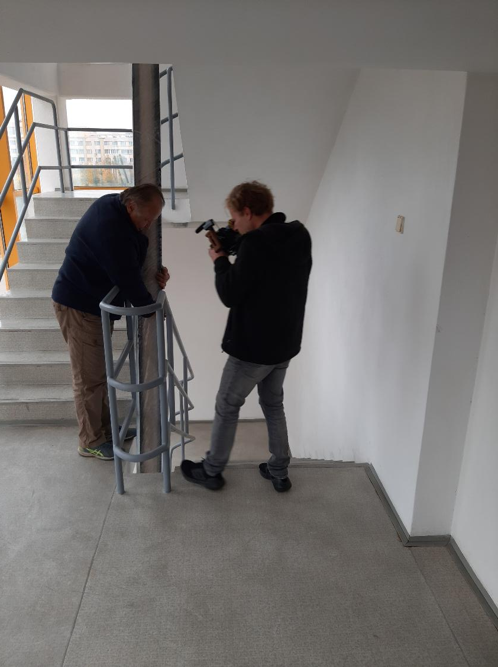
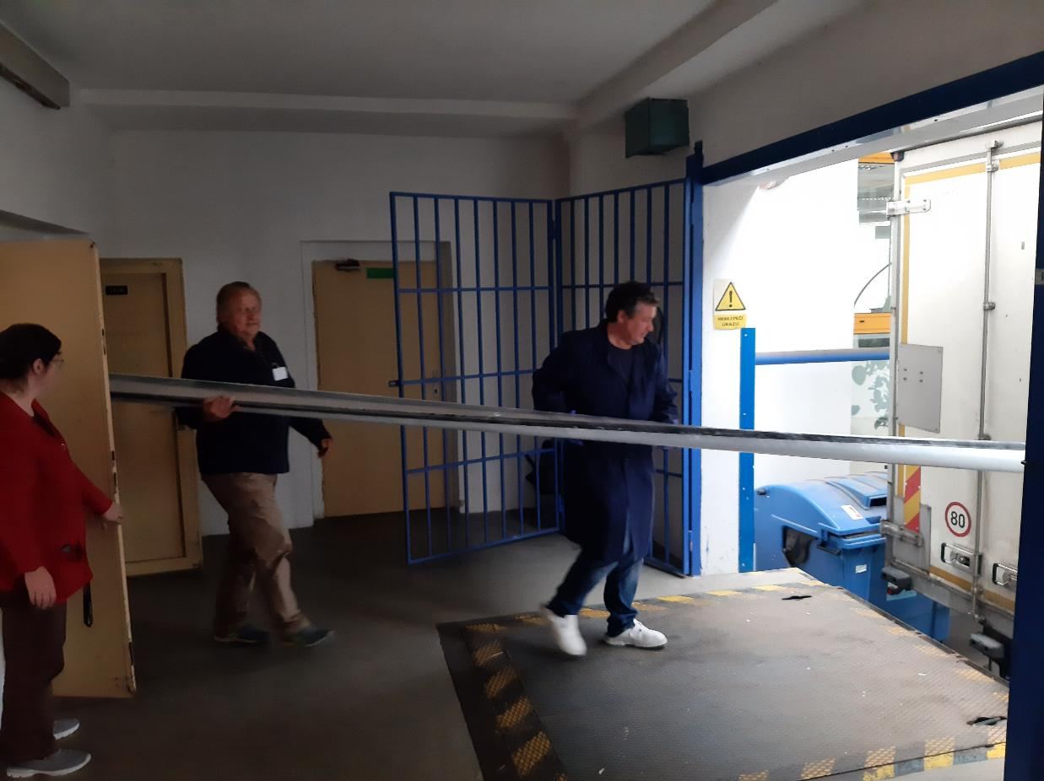
Notes:
Final steps were easy, but we had to move through two floors and ymany doors on the way out… And of course back

Slide 21
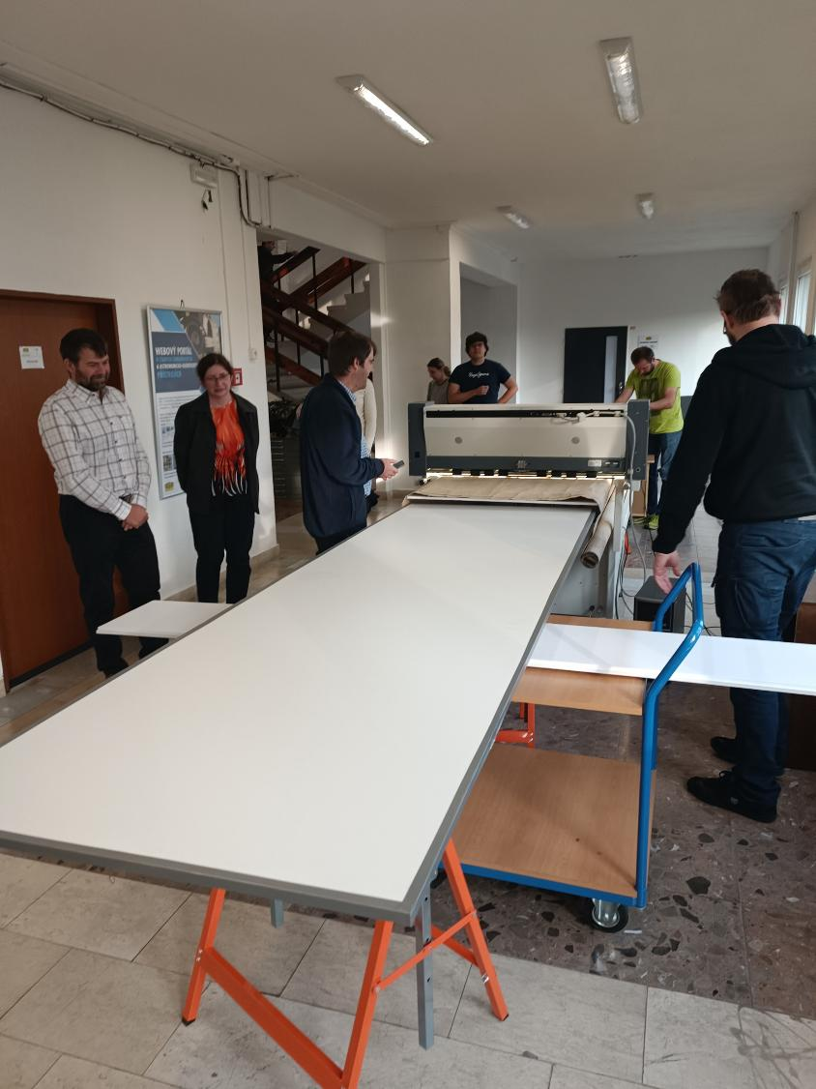
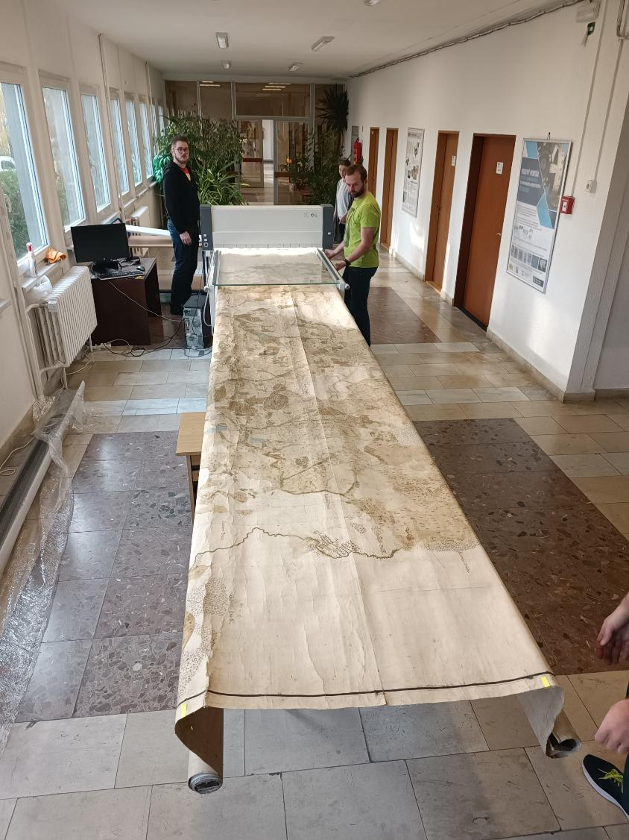
Notes:
Also digitization itself was not an easy process and required whole team to move the map around.

Slide 22

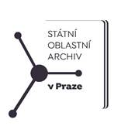

Thank You
The presentation was created on the basis of the targeted support of the Ministry of Culture ČR as part of the project DH23P03OVV045 – „Large-format archival materials with limited access to the public as neglected cultural heritage“, which fulfils the programme and support of applied research and experimental development of national and cultural identity for the years 2023–2030 (NAKI III), funded by the Ministry of Culture Czech Republic.

